Slide 1
Let’s get into PostgreSQL performance
PGDay India
26 February 2016
Himanchali
himamahi09@gmail.com

Slide 2
#Who Am I
himanchali@inmobi.com
Technical Lead – Production & Infrastructure Engineering

Slide 3
What kind of databases do we have..
OLTP
OLAP

Slide 4
In today’s talk…
Query
Performance

Slide 5
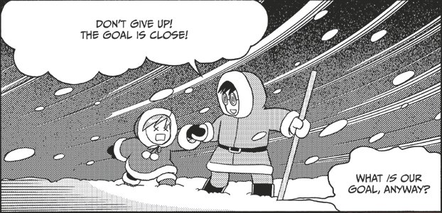
The fastest query ☺

Slide 6
The host
CPU : 40 core
RAM : 128 GB
Disk : SSD RAID 1
Database size : 280GB

Slide 7
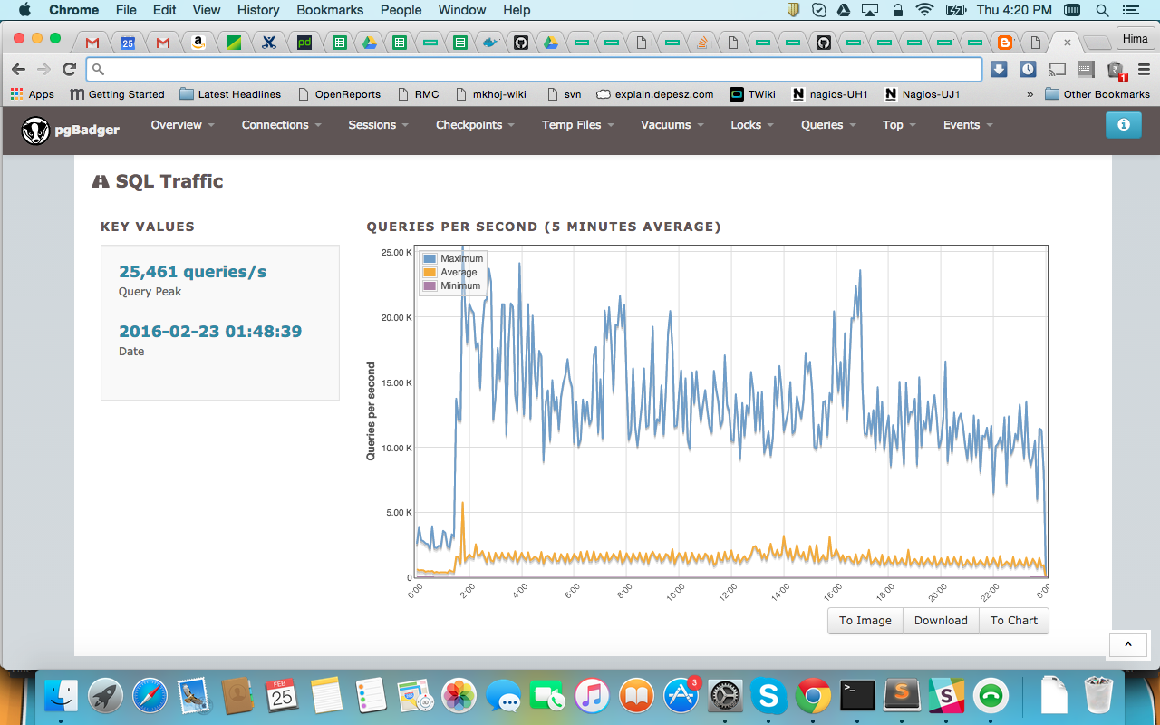
QPS

Slide 8
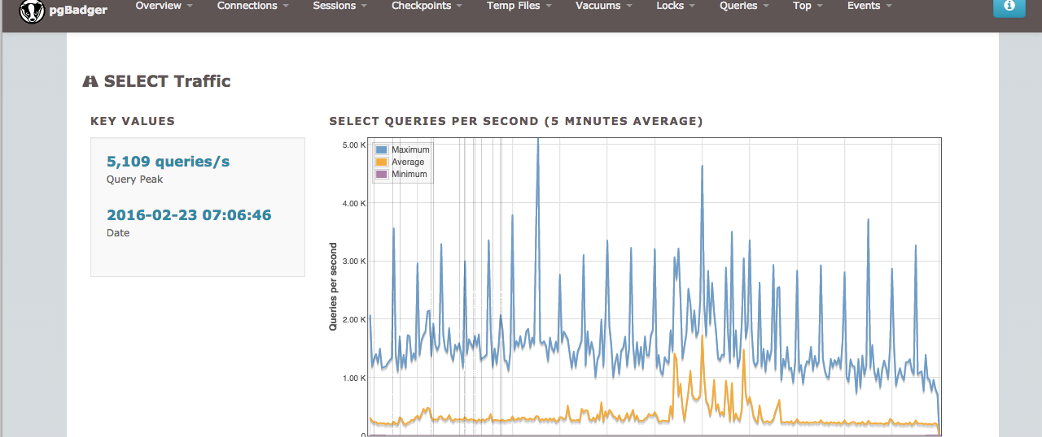
Read

Slide 9
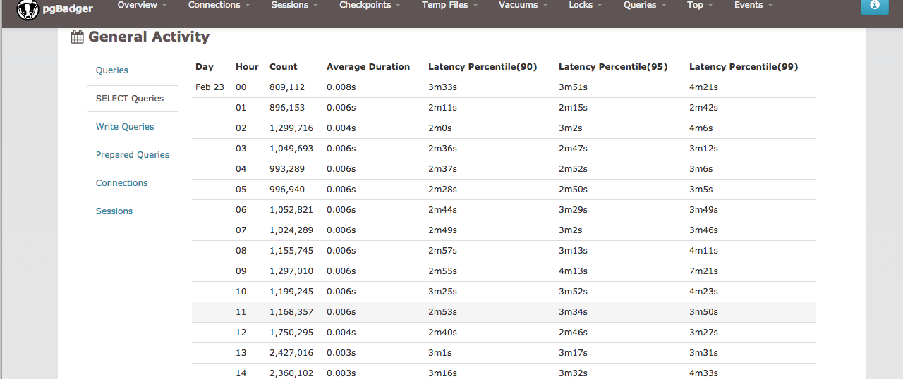
Read Latency

Slide 10
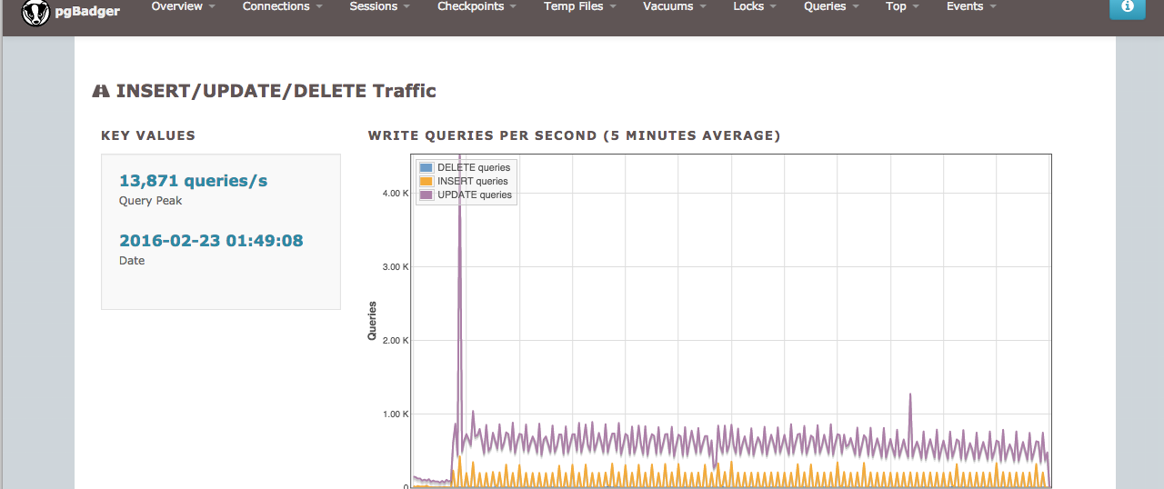
Write

Slide 11
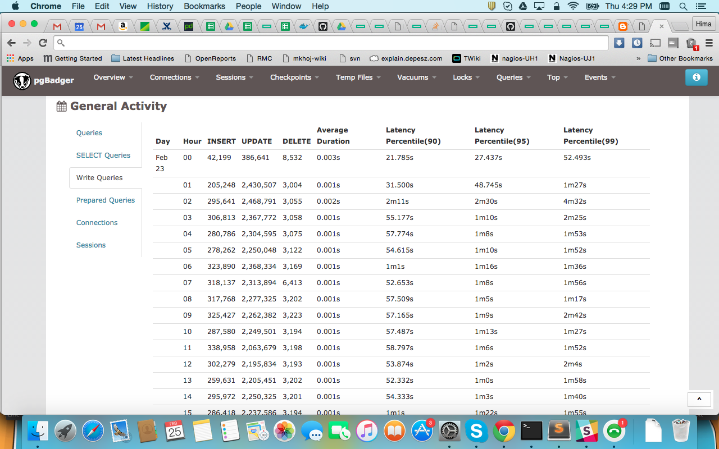
Write latency

Slide 12
Hardware matters
Specially RAM
Cache
CREATE EXTENSION pg_buffercache;

Slide 13
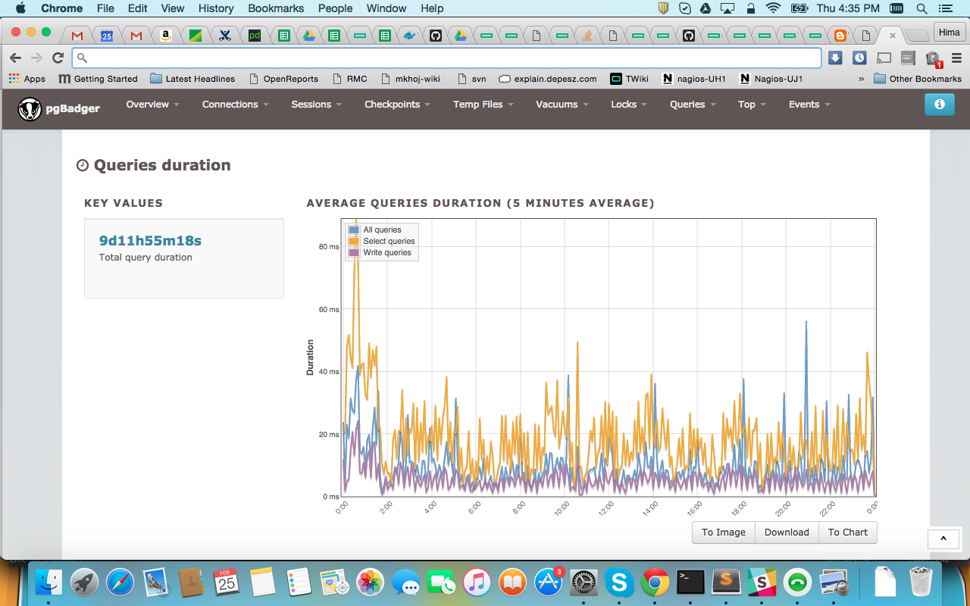
64GB RAM

Slide 14
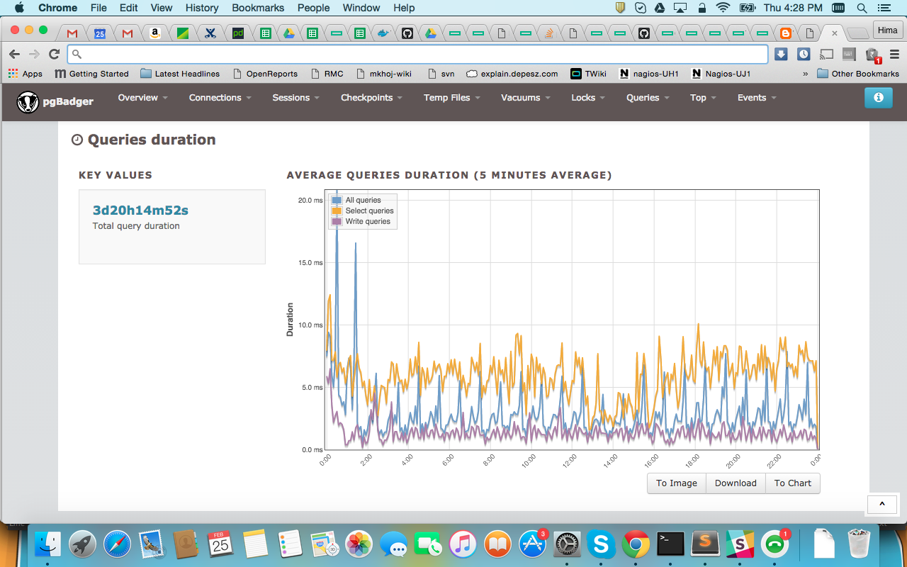
128GB RAM

Slide 15
Benchmark your PostgreSQL
Use pgbench

Slide 16
Tune the configs
Shared_buffer
Checkpoint segments
Synchronous_commit
Work_mem/Maintenance_work_mem
autovacuum

Slide 17
Query optimization
Client side optimization
Use temp tables
Avoid ‘Select *’

Slide 18
Optimization…
Avoid misuse of sub query
Proper use of joins
Group by push down
Avoid ‘not in’ for a big set of filter
Partition pruning

Slide 19
Indexes
Composite indexes
Partial indexes
Function indexes
Index on foreign key
Specific order by

Slide 20
Some query examples
Composite indexes
Depends on the order
for SELECT name FROM test WHERE a = 1 AND b = 0;
Index : CREATE INDEX test_idx ON test (a, b);
Won't work for : WHERE a = 1 OR b = 2
WHERE b = 2
Partial indexes
Select name from emp where gender=‘F’;
CREATE INDEX test_part_idx ON test(gender) where gender=‘F’;

Slide 21
Example continues…
Function Indexes
SELECT name FROM test WHERE lower(a) = 'value';
CREATE INDEX test_lower_idx ON test (lower(a));
Specific order by
For queries with order by like ORDER BY a ASC, b DESC
CREATE INDEX idx ON test (a ASC , b DESC);

Slide 22

But no over indexing….

Slide 23
What else …
How can I forget those many stored procedures in my DB .
User defined functions for complex business logic
Saving time between application and DB
Get rid of dependency of language used by application

Slide 24
Explain
Find the issue in the query

Slide 25
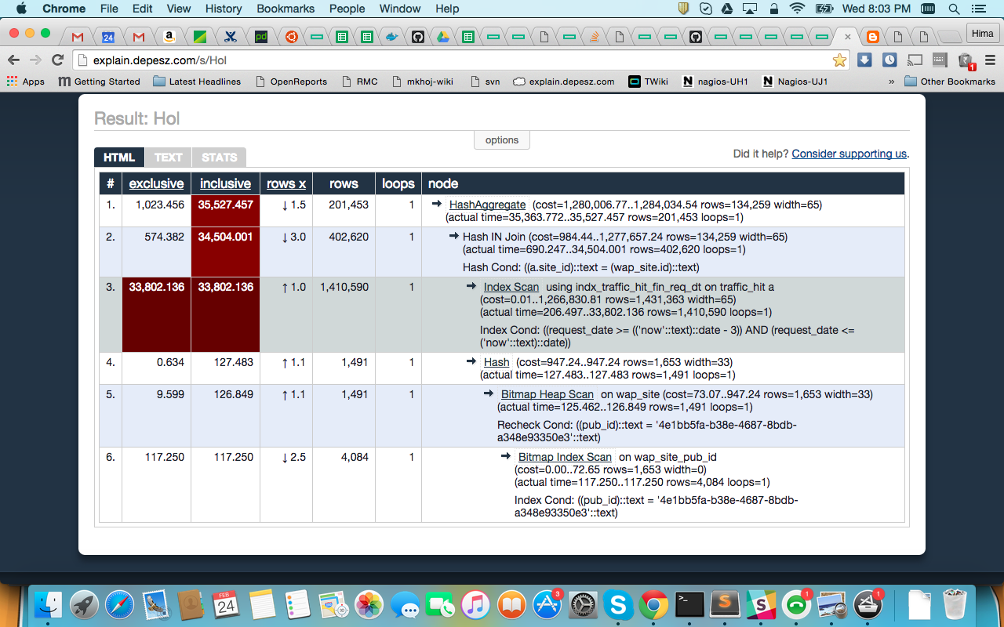
http://explain.depesz.com/

Slide 26
Give hint to optimizer
Analyze
Planner configuration
e.g. enable_nestloop, enable_seqscan
Planner cost
e.g. effective_cache_size , random_page_cost

Slide 27
Writes
bulk load precautions
create ..copy .. then index and constraints
https://bucardo.org/wiki/Split_postgres_dump
Increase maintenance_work_mem
Increase checkpoint_segments
Never ever forget to run analyze / vacuum analyze

Slide 28

Factors
Hardware
Configuration tuning
Query optimization
Indexing
Maintenance

Slide 29

Is the performance good??
Monitor the stats

Slide 30
Monitoring is easy !
Use of enriched statistics collector
User stats
DB stats
Table stats
Index stats
And many more…
pg_log monitoring
Log everything if you want to monitor everything

Slide 31
Thank You ☺!!
QUESTIONS??

